Slide 1



HEARTS AND MINDS · A PATIENT'S STORY THROUGH THE OPERATING MODEL
Sean.
Reaching him.
Sean has been on every NHS list since he was a child. Being on the lists has never been the hard part. The path from being identified, to getting the test done on time, to the result reaching the family who can act on it. That is where it falls down. The clinic venue assumes a prepared adult arriving on time. Sean is not that adult, for reasons that are neither his fault nor solvable by a flag on his record. This is the story of what changes when the test comes to him.
Sean
Horizontal cohort patient · The access story
Hearts and Minds · Sean's journey · HomeTest operating model · September 2026
Commercial positions are agreed in principle and remain subject to the live procurement.
Notes:
Sean's story, told through the operating model. Open on the person, not the pathway.

Slide 2
SEAN'S JOURNEY AT A GLANCE
Identification has never been the problem. The chain after it is.
1
→
2
→
3
→
4
→
5
Stratification: the cohort the system identifies but doesn't reach
Identification: the offer that reaches the people who can act on it
Diagnosis: a test on his terms
Treatment: the result lands with the people who can act on it
Long-term optimisation: the cohort the system actually holds
in his own kitchen
the chain that doesn't break
on every list, never quite reached
the offer reaches the people who can act on it
the result lands with people who can act
THE ACCESS NORTH STAR
WHY THIS WORKS FOR HIM
Identification has never been the problem. The chain after it is.
A test at the kitchen table. A family member in the loop. An appointment that doesn't fight the rest of his life.
Sean's cohort lives 19.5 years shorter than the rest of the population. Thirty-nine per cent of those deaths are judged avoidable. The flags, the registers and the legal duty to provide accessible information have all been in place for years. The home pathway is the first venue where the system finally reaches the person it has been carrying on a list.
Sean
The clinic appointment fights every other thing in Sean's day: the OCD-driven late nights, the handwashing routines, the missed bus, the lost letter, the family that doesn't know it was even happening. Move the venue, register the family as authorised, and almost all of that friction disappears. The independence Sean fights for stays whole.
Horizontal cohort patient · The access story
Hearts and Minds · Sean's journey · HomeTest operating model · September 2026
Commercial positions are agreed in principle and remain subject to the live procurement.
2

Slide 3
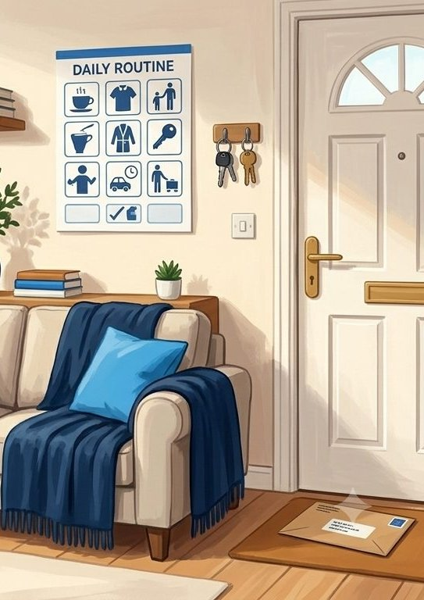
SEAN'S JOURNEY · STAGE 1 OF 5
01
Stratification: the cohort the system identifies but doesn't reach
on every list, never quite reached
Sean has been on the learning disability register since he was a child. The annual-health-check uptake across the cohort sits at 79.9 per cent. The reasonable-adjustment flag has sat on his record since the Accessible Information Standard became a legal duty in 2016. Identification has never been the problem. The system has always known he exists.
“Being on the register has never been the problem. There are too many steps between the register and the result for him not to slip somewhere along the chain.” Sean's brother
WHAT THE MODEL IS DOING UNDERNEATH
THE OLD WAY
79.9% of people on the learning disability register had an annual health check (March 2025). The Reasonable Adjustment Digital Flag is a national NHS record flag. The Accessible Information Standard has been a legal requirement since 2016. None of the identification infrastructure needs to be built. It has existed for years. What hasn't worked is the chain that turns identification into a finished test, a delivered result, and a treatment that actually lands.
Identify the cohort. File the flag. Send the standard letter. Run the standard appointment. Record the DNA when it doesn't happen. Send the next reminder a year later. The cycle holds the identification step. It has never held the engagement step.
WHO SEAN'S CARE TEAM SEES Sean's GP. The annual health check team. The learning disability liaison nurse. Sean's brother and his overnight carers.
Hearts and Minds · Sean's journey · HomeTest operating model · September 2026
Commercial positions are agreed in principle and remain subject to the live procurement.
3
Notes:
Stage 1: Stratification: the cohort the system identifies but doesn't reach. 79.9% of people on the learning disability register had an annual health check (March 2025). The Reasonable Adjustment Digital Flag is a national NHS record flag. The Accessible Information Standard has been a legal requirement since 2016. None of the identification infrastructure needs to be built. It has existed for years. What hasn't worked is the chain that turns identification into a finished test, a delivered result, and a treatment that actually lands.

Slide 4
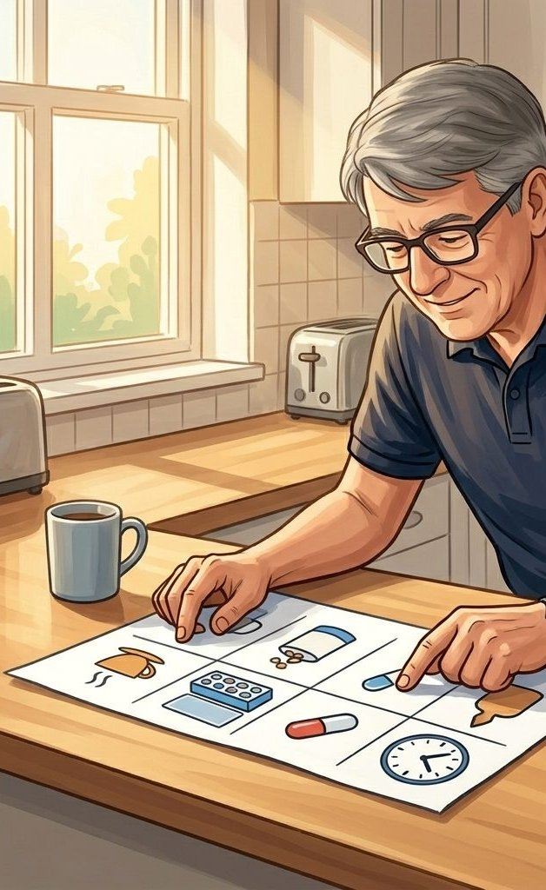
SEAN'S JOURNEY · STAGE 2 OF 5
02
Identification: the offer that reaches the people who can act on it
the offer reaches the people who can act on it
The home-test offer travels through the people who can actually translate it for Sean. His brother. The carers who stay with him overnight. The materials are easy-read and arrive in a format he can engage with at his own pace, when he's ready. The offer no longer depends on a letter surviving the journey from the doormat to anyone who can act on it.
“I want to do this. I just need to know when.” Sean
WHAT THE MODEL IS DOING UNDERNEATH
THE OLD WAY
Easy-read materials. Alternative-format letters. Support-network engagement designed into the platform from the start. The reasonable-adjustment flag triggers the alternative communication route. The offer travels through the people who can support him, not through an unopened letter.
A letter arrives at the front door. Sometimes Sean doesn't pick it up. Sometimes it goes in the bin. Sometimes it arrives when no carer is there. Even when it's read, the appointment that follows wants him out of the door at nine in the morning. His OCD-driven sleep cycle puts him to bed at three or four in the morning. The handwashing routines take real time before he can leave the house. The bus has already gone. The family often doesn't know the appointment was even happening, because Sean doesn't always tell them and the care team doesn't always tell them either. The DNA gets recorded. The bloods don't get done. The next reminder lands at the same front door.
WHO SEAN'S CARE TEAM SEES Sean's brother. The overnight carers. The learning disability liaison nurse. The easy-read materials team.
Hearts and Minds · Sean's journey · HomeTest operating model · September 2026
Commercial positions are agreed in principle and remain subject to the live procurement.
4
Notes:
Stage 2: Identification: the offer that reaches the people who can act on it. Easy-read materials. Alternative-format letters. Support-network engagement designed into the platform from the start. The reasonable-adjustment flag triggers the alternative communication route. The offer travels through the people who can support him, not through an unopened letter.

Slide 5

SEAN'S JOURNEY · STAGE 3 OF 5
03
Diagnosis: a test on his terms
in his own kitchen
The kit arrives. The test happens on Sean's terms, on a day when he's calm, after a night he actually slept, with his brother in the room. He takes the sample himself. The independence he fights for stays whole. The test he's missed too many times actually happens, and the result goes straight to the people who need to see it.
“I don't mind the needle. I needed it to come to my house.” Sean
WHAT THE MODEL IS DOING UNDERNEATH
THE OLD WAY
Home venue moves the appointment off the clinic clock. Sean does the sample himself, not is done to. The kit is the appointment. No bus. No waiting room. No nine-in-the-morning alarm. The clinical pathway is unchanged. The biochemical result is the same. What changes is the venue, the timing, and the design recognition that Sean's engagement profile is the constraint to design around, not the problem to blame.
Refer for a clinic slot. Watch the appointment fight Sean's sleep cycle, his OCD-driven routines, the lost letter, the missed bus. Record the DNA. Refer again. Cycle.
WHO SEAN'S CARE TEAM SEES Sean. His brother. The overnight carers. The home-test kit supplier. The GP holding the clinical pathway.
Hearts and Minds · Sean's journey · HomeTest operating model · September 2026
Commercial positions are agreed in principle and remain subject to the live procurement.
5
Notes:
Stage 3: Diagnosis: a test on his terms. Home venue moves the appointment off the clinic clock. Sean does the sample himself, not is done to. The kit is the appointment. No bus. No waiting room. No nine-in-the-morning alarm. The clinical pathway is unchanged. The biochemical result is the same. What changes is the venue, the timing, and the design recognition that Sean's engagement profile is the constraint to design around, not the problem to blame.

Slide 6

SEAN'S JOURNEY · STAGE 4 OF 5
04
Treatment: the result lands with the people who can act on it
the result lands with people who can act
The result goes to two places at once: Sean's GP record, and the family member he's nominated as his authorised representative. The clinical conversation that follows happens in a format Sean can engage with, and his brother is in the loop from the moment the result lands. The “we didn't know it was happening” gap closes. The medication, the follow-up, the next step. All of them have someone close to Sean who can support them.
“I don't want to take this off him. I want to know it isn't falling through.” Sean's brother
WHAT THE MODEL IS DOING UNDERNEATH
THE OLD WAY
The clinical treatment pathway is unchanged. The authorisation model is the change. Sean's nominated next-of-kin (his brother) is registered on the HomeTest system as his authorised representative. Notify rails carry the result to two places: Sean's record at the practice, and his family. The reasonable-adjustment flag stays live through every handover, but the new mechanic underneath it is the notification to the people who can act.
Result lands at the practice. Maybe it's flagged. Maybe a letter goes out. Maybe Sean opens it. Maybe he doesn't. Maybe the family find out months later, when something has already gone wrong. The medication never gets taken consistently because nobody close to him knows it was prescribed.
WHO SEAN'S CARE TEAM SEES Sean's GP. Practice pharmacist. The learning disability liaison nurse. Sean's brother as authorised representative. The overnight carers.
Hearts and Minds · Sean's journey · HomeTest operating model · September 2026
Commercial positions are agreed in principle and remain subject to the live procurement.
6
Notes:
Stage 4: Treatment: the result lands with the people who can act on it. The clinical treatment pathway is unchanged. The authorisation model is the change. Sean's nominated next-of-kin (his brother) is registered on the HomeTest system as his authorised representative. Notify rails carry the result to two places: Sean's record at the practice, and his family. The reasonable-adjustment flag stays live through every handover, but the new mechanic underneath it is the notification to the people who can act.

Slide 7
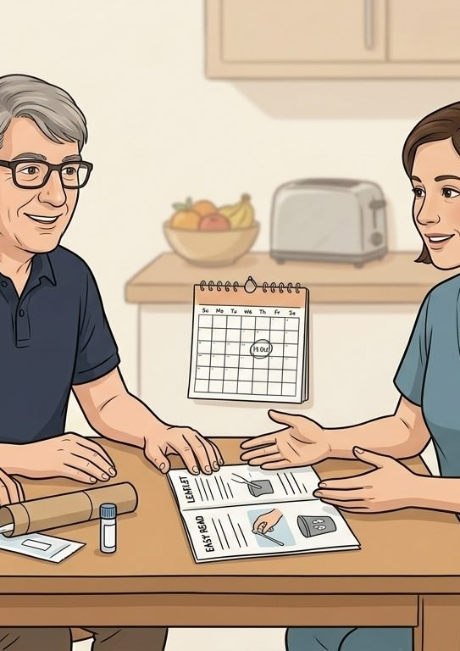
SEAN'S JOURNEY · STAGE 5 OF 5
05
Long-term optimisation: the cohort the system actually holds
the chain that doesn't break
The next test is on a calendar Sean's brother can see. The flags stay live. The materials stay accessible. Sean's parents are in their seventies, and the day responsibility shifts to his brother is the day the model proves whether it's a system or just a policy. The 19.5-year mortality gap for people with a learning disability is not Sean's problem. Closing it is what holding him properly is made of.
“My parents are in their seventies. Soon this is on me. The model is what stops me failing him.” Sean's brother
WHAT THE MODEL IS DOING UNDERNEATH
THE OLD WAY
39% of reviewed deaths of people with a learning disability were assessed as avoidable (LeDeR annual report 2023, published 2025). Persistence is what closes that gap: persistence of the authorisation, persistence of the flag, persistence of the support-network notification. The home pathway holds the cohort the system identifies. That is the response that turns identification into care.
Health needs surface as emergencies because routine monitoring lapsed. For Sean's cohort, the median age of death is 62.3 years. That is 19.5 years younger than the general population. That gap is what happens when the system stops at identification.
WHO SEAN'S CARE TEAM SEES Sean. His brother as authorised representative. The overnight carers. Sean's GP. The learning disability liaison nurse. The commissioner looking at the cohort-level numbers.
Hearts and Minds · Sean's journey · HomeTest operating model · September 2026
Commercial positions are agreed in principle and remain subject to the live procurement.
7
Notes:
Stage 5: Long-term optimisation: the cohort the system actually holds. 39% of reviewed deaths of people with a learning disability were assessed as avoidable (LeDeR annual report 2023, published 2025). Persistence is what closes that gap: persistence of the authorisation, persistence of the flag, persistence of the support-network notification. The home pathway holds the cohort the system identifies. That is the response that turns identification into care.

Slide 8
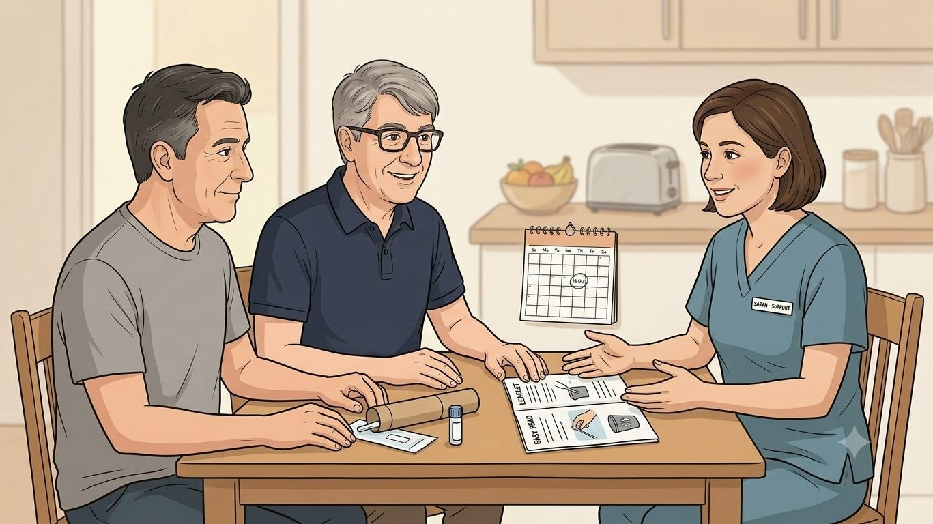
SEAN'S WIN
Identified. And finally reached.
THE MONEY IN THIS STORY
Sean's story is not a cost case, and this panel does not pretend it is one. A kit that works for Sean costs the same to buy as one that does not. What the model prices is the difference between reaching him now and treating him late, and late presentation is the most expensive route through any pathway, in money as well as in everything that matters more. Reasonable adjustment is not a premium product; it is the same per-activity price doing its job for the people the appointment system failed.
For Sean, and the cohort whose health depends on the system reaching them rather than the other way round, the model isn't about replacing the clinic. It's about closing the gap between knowing his name and actually doing the bloods. The test gets done. The result lands with the people who can act on it. The independence he fights for stays intact. The avoidable death that doesn't happen is the one the system finally chose not to allow.
Identification has never been the problem. The chain after it is.
Sean
Horizontal cohort patient · The access story
Hearts and Minds · Sean's journey · HomeTest operating model · September 2026
Commercial positions are agreed in principle and remain subject to the live procurement.
8

Slide 9
Sean
Horizontal cohort patient · The access story
Identification has never been the problem. The chain after it is.
Hearts and Minds · Sean's journey · HomeTest operating model · September 2026
Commercial positions are agreed in principle and remain subject to the live procurement.
9

